Slide 1
LECTURE # 03
EXPLORING KNIME IDE
DATA MINING

Slide 2

WHAT IS KNIME:
KNIME, which stands for Konstanz Information Miner, is an open-source data analytics platform that allows users to visually create data science workflows. It provides a graphical interface for designing, executing, and managing data analysis processes, making it accessible to users with varying levels of technical expertise.
With KNIME, users can perform a wide range of data-related tasks, including data preprocessing, exploratory data analysis, machine learning model development, and predictive analytics. The platform offers a vast collection of pre-built nodes that represent different data processing and analysis operations. These nodes can be easily dragged and dropped onto a workflow canvas and connected to create complex data pipelines.

Slide 3

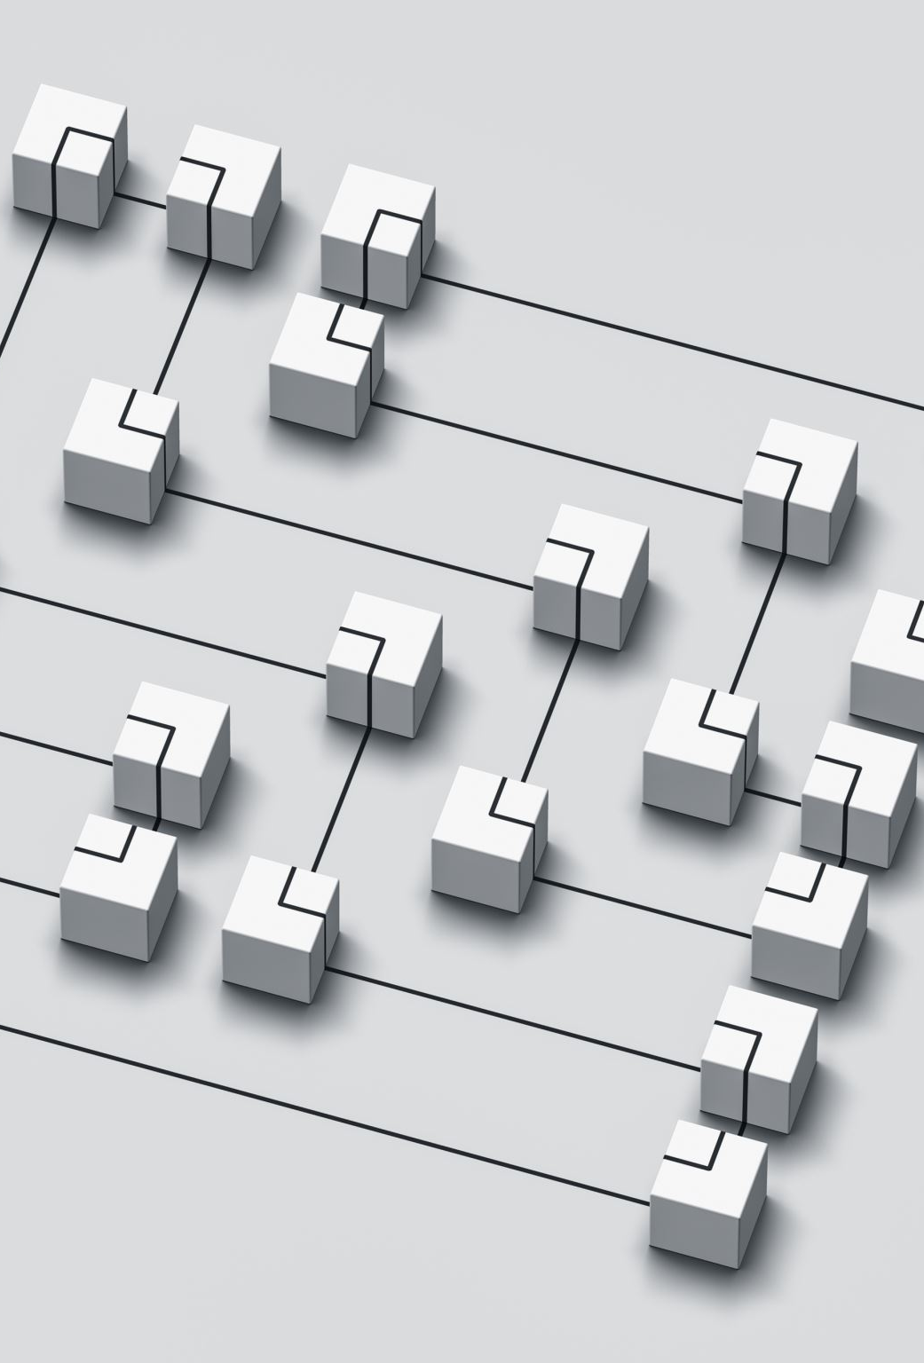

KEY FEATURE OF KNIME:
One of the key features of KNIME is its flexibility and extensibility. Users can customize their workflows by adding or creating new nodes, integrating external libraries and tools, and incorporating their own scripts and algorithms

Slide 4
WHERE KNIME IS CURRENTLY USED:
KNIME is widely used across various industries and domains, including finance, healthcare, retail, and manufacturing, for tasks such as customer segmentation, fraud detection, predictive maintenance, and more. Its user-friendly interface, extensive functionality, and strong community support make it a popular choice for data scientists, analysts, and researchers worldwide.

Slide 5
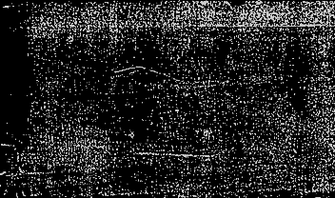
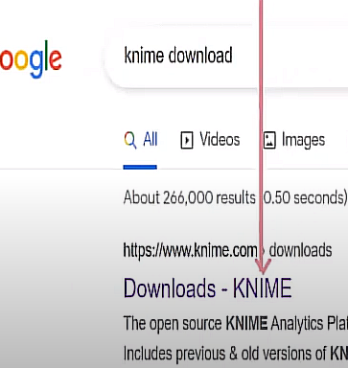
INSTALLATION STEPS OF KNIME: (DOWNLOAD)
Download KNIME:
  Visit the official KNIME website at https://www.knime.com/download to download the KNIME Analytics Platform.
  On the download page, you'll see different versions available for various operating systems. Choose the appropriate version for your operating system (Windows, macOS, or Linux) and click on the download button.

Slide 6
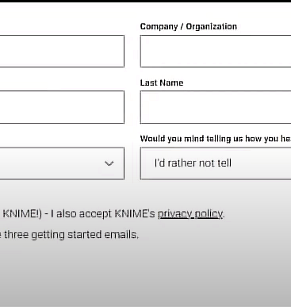
SIGNUP KNIME:

Slide 7
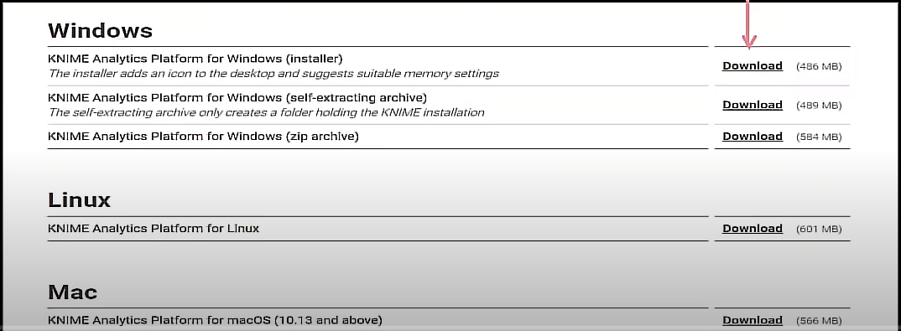
FOR WINDOWS

Slide 8

INSTALL KNIME:
Install KNIME:
  Once the download is complete, locate the downloaded installer file on your computer and double-click to start the installation process.
  Follow the on-screen instructions provided by the installer. Typically, this involves agreeing to the terms and conditions, choosing the installation directory, and selecting additional components to install (optional).
  Click on the "Install" or "Finish" button to complete the installation process.

Slide 9

LAUNCH KNIME:
Launch KNIME:
  After the installation is complete, you can launch KNIME by double-clicking the KNIME Analytics Platform icon on your desktop or by searching for KNIME in your computer's applications menu.
  When you launch KNIME for the first time, it may prompt you to select a workspace directory where your workflows and data will be stored. Choose a suitable directory and click "OK."

Slide 10

START KNIME:
Start Using KNIME:
  Once KNIME is installed and configured, you can start using it to create data science workflows, analyze data, build machine learning models, and more.
  Explore the various features, nodes, and functionalities of KNIME by creating your first workflow or by following tutorials available on the KNIME website or community forums.

Slide 11

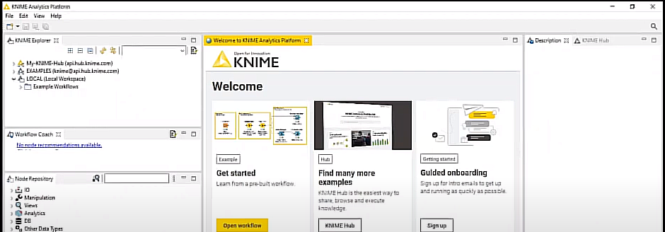

KNIME PLATFORM

Slide 12
KNIME LINGO:
WORKSPACE: Stores your work. Workspace contains workflow groups built using the workflow editor.
WORKFLOW: KNIME does not works with scripts, it works with workflows. A workflow is an analysis flow, which is the sequence of the analysis steps necessary to reach a given result. It is the pipeline of the analysis process, like:
Step 1: Read Data
Step 2: Clean Data
Step 3: Filter Data
Step 4: Train a model.
KNIME implements its workflows graphically. Each step of a data analysis is executed by a little box, called a node.

Slide 13
NODES & ITS COLOR REPRESENTATION:
NODE: A node is the single processing unit of a workflow. A node takes a data set as input, processes it, and makes it available on its output port.
Every node in KNIME has three states
In active and not yet configured RED traffic light
Configured but not yet executed YELLOW traffic light
Executed successfully GREEN traffic light
If the node is executed with errors (unsuccessfully), its status stays at the yellow traffic light.
Node containing other nodes are called meta nodes.
WORK BENCH: It includes a workflow editor where the user can create the workflows. The KNIME workbench consists of a top menu, a tool bar, and a few panels. Panels can be closed and moved around.

Slide 14
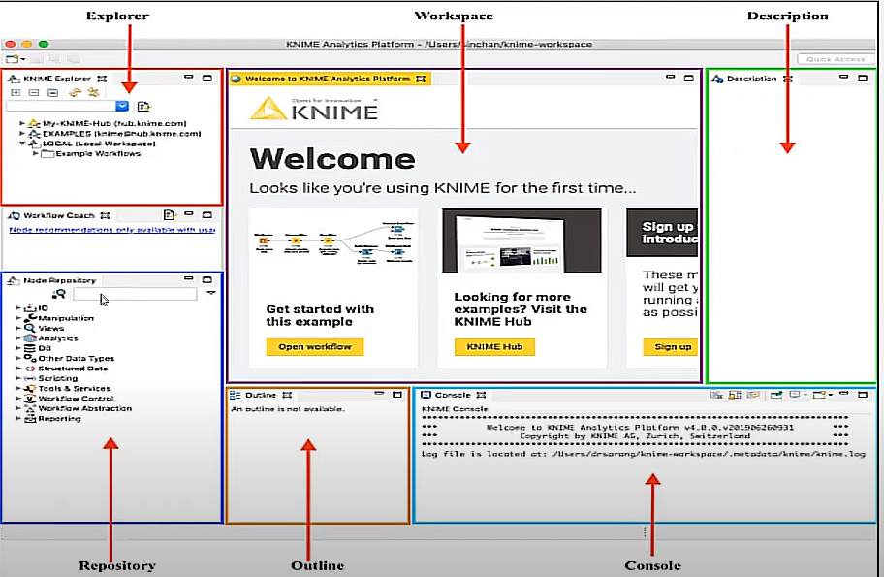
KNIME INTERFACE:

Slide 15
WHY KNIME:
User-Friendly Interface: KNIME provides a user-friendly graphical interface that allows users to visually design and build data analysis workflows. This makes it accessible to users with varying levels of technical expertise, including those without programming skills.
Extensive Functionality: KNIME offers a wide range of built-in nodes for data manipulation, analysis, and visualization. These nodes cover various data processing tasks, machine learning algorithms, statistical methods, and integration with external tools and platforms.
Flexibility and Customization: KNIME is highly flexible and customizable, allowing users to create workflows tailored to their specific requirements. Users can add or create new nodes, integrate external libraries and tools, and incorporate their own scripts and algorithms to extend KNIME's functionality.
Open-Source and Community Support: KNIME is an open-source platform supported by a large and active community of users, developers, and contributors. The community provides resources, tutorials, plugins, and support forums, making it easy for users to learn, collaborate, and troubleshoot issues.
Scalability and Performance: KNIME is designed to handle large volumes of data and complex analysis tasks. It supports parallel processing, distributed computing, and integration with big data technologies, allowing users to scale their workflows to handle data of any size.

Slide 16
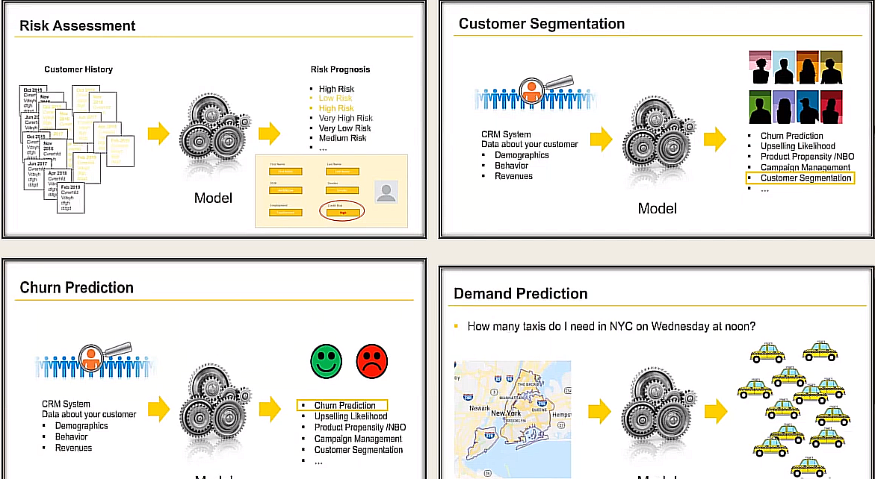
APPLICATIONS OF KNIME:

Slide 17
Knime console view:
In KNIME, the "Console View" provides a real-time log of messages, warnings, errors, and other system information generated during the execution of workflows. It serves as a debugging and troubleshooting tool, allowing users to monitor the progress of workflow execution and diagnose any issues that may arise.

Slide 18
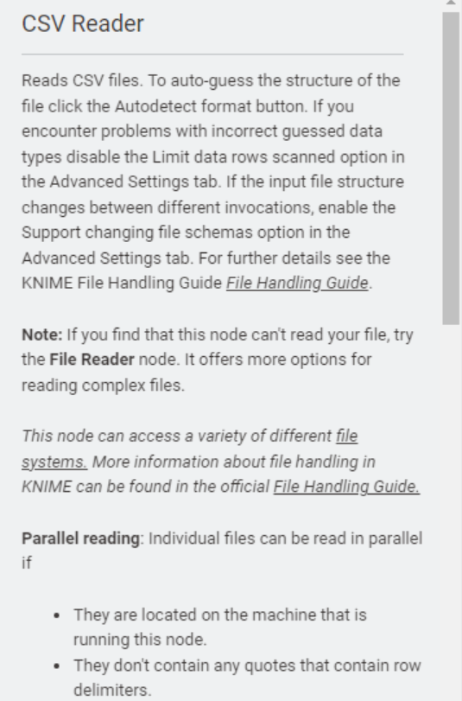
Knime description view:
In KNIME, the "Description View" provides a space for users to add descriptive text and annotations to their workflows. It allows users to document and explain the purpose, functionality, and workflow logic for themselves and other users who may interact with or review the workflow.

Slide 19
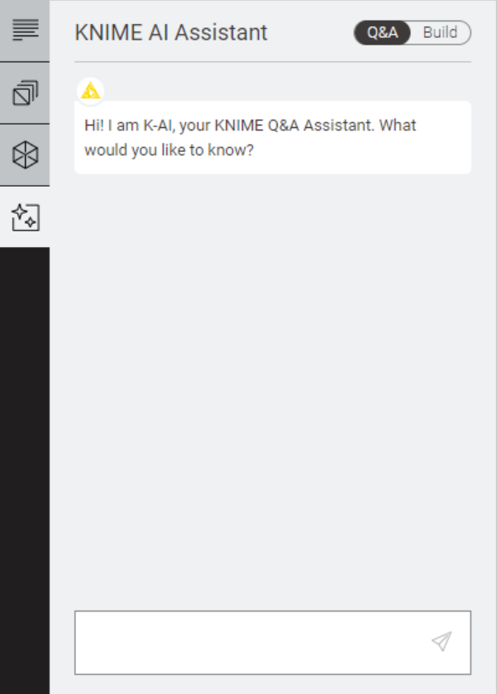
Knime ai ASSISTANT
KNIME provides various nodes and integrations for building and deploying machine learning models, including data preprocessing, feature engineering, model training, evaluation, and deployment. Additionally, KNIME integrates with popular machine learning libraries and frameworks such as TensorFlow, Kera's, Scikit-learn, and H2O.ai, allowing users to access advanced algorithms and techniques within their workflows.
While there isn't a dedicated "AI Assistant" feature in KNIME, users can utilize the platform's comprehensive set of tools, nodes, and integrations to perform AI and machine learning tasks effectively. Additionally, KNIME's extensive documentation, community forums, and online resources provide valuable support and guidance for users seeking assistance with their AI and machine learning projects.

Slide 20
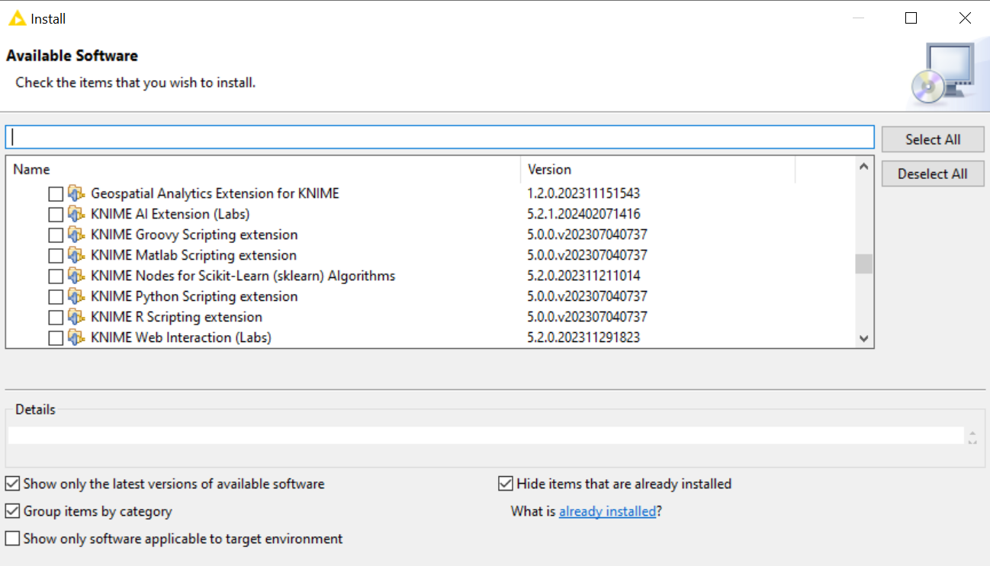
KNIME EXTENSIONS:
KNIME Extensions refer to additional modules or plugins that extend the functionality of the KNIME Analytics Platform. These extensions provide users with access to a wide range of additional nodes, integrations, and features to enhance their data analysis, machine learning, and workflow development capabilities.

Slide 21
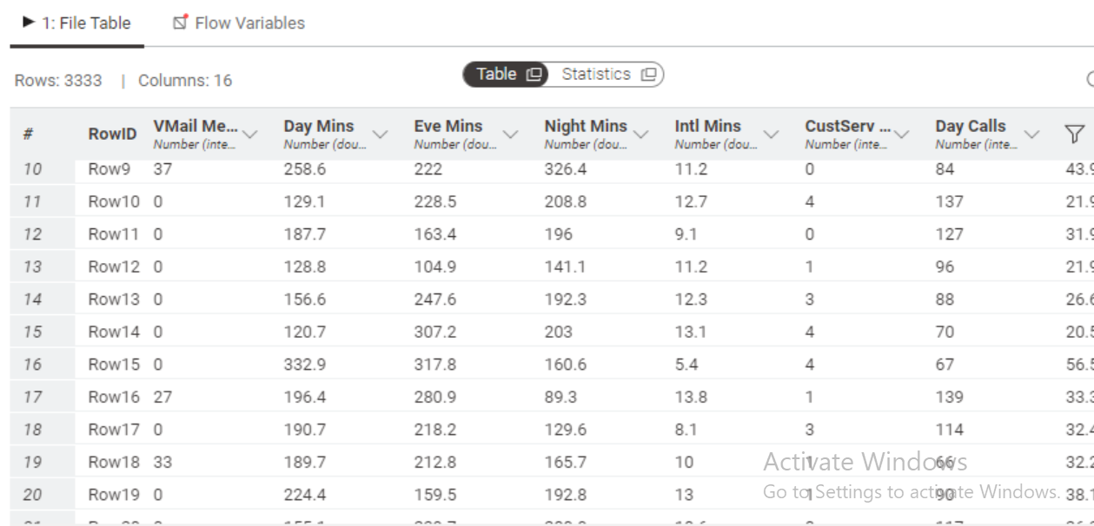
EXECUTION VIEW (TABLE DATA & STATISTICS)

Slide 22
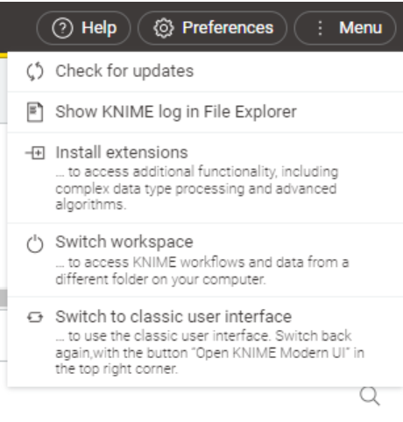
KNIME MENU OPTIONS:

Slide 23
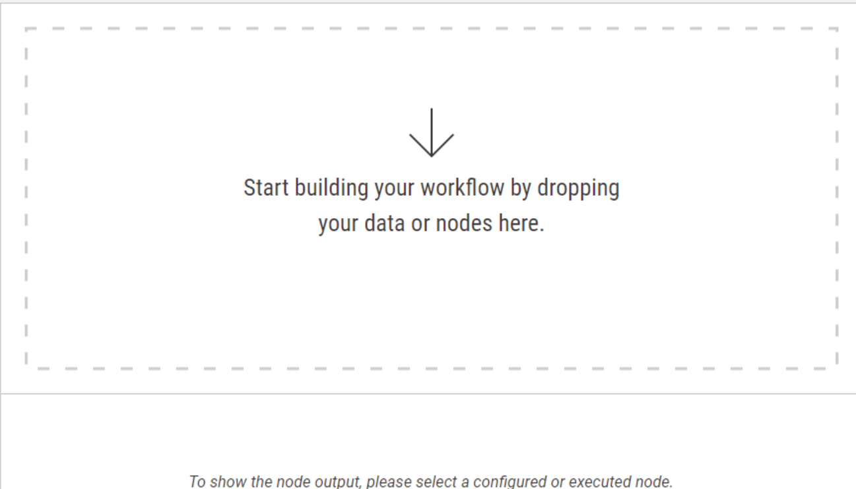
WORKSPACE IN KNIME:
In KNIME, the "Workspace" refers to the main area within the user interface where users can create, organize, and edit their workflows. It serves as the primary canvas for building and designing data analysis pipelines, machine learning models, and other data processing tasks.

Slide 24
Knime nodes

Slide 25
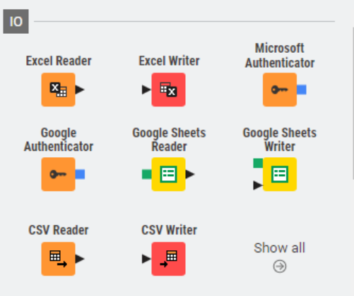
Knime i/o nodes

Slide 26
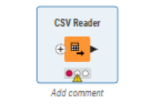
(csv reader)
Reads CSV files. To auto-guess the structure of the file click the Autodetect format button. If you encounter problems with incorrect guessed data types disable the Limit data rows scanned option in the Advanced Settings tab.

Slide 27
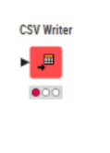
Csv writer
This node writes out the input data table into a file or to a remote location denoted by an URL. The input data table must contain only string or numerical columns. Other column types are not supported.

Slide 28
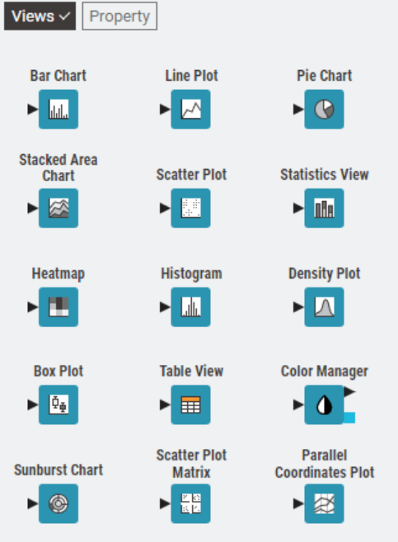
Knime nodes (visualizations)
The view can be accessed either via the “Open view” action on the executed node or on KNIME Hub.
In the node configuration, you can choose the aggregation method and enable certain controls, which are then available in the view. This includes the ability to choose different columns for the category and frequency axis or the possibility to set a title.
The configuration also offers a preview of the view, which should help to get the bar chart in the desired shape quickly.
Since missing values as well as Nan (not a number) or infinite values cannot be displayed in the view, they will be omitted.

Slide 29
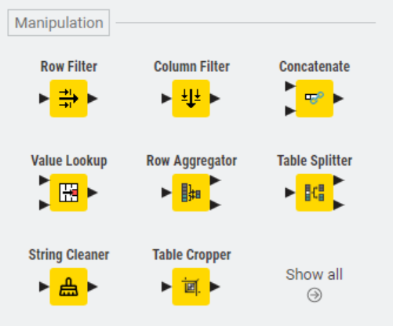
Knime manipulation nodes

Slide 30
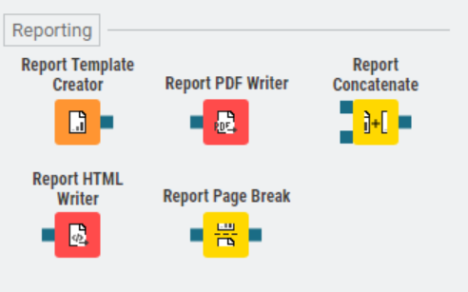
Knime reporting nodes

Slide 31
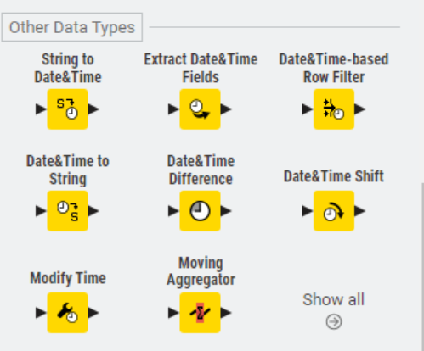
Other datatypes nodes

Slide 32
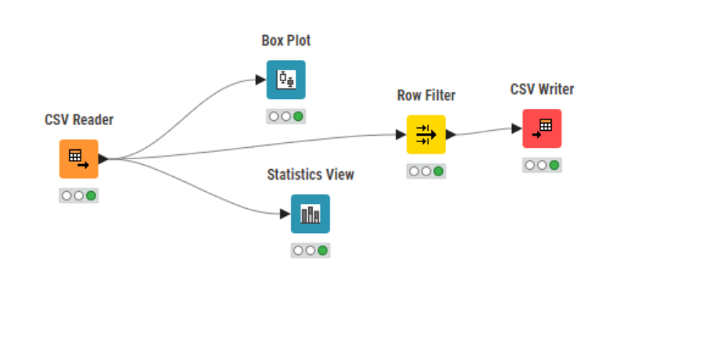
EXAMPLE 01: simple workflow

Slide 33
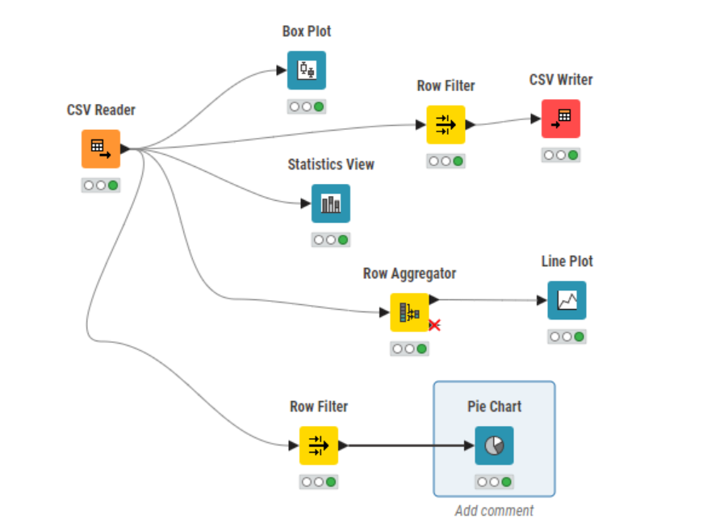
Example 02: detailed workflow

Slide 34
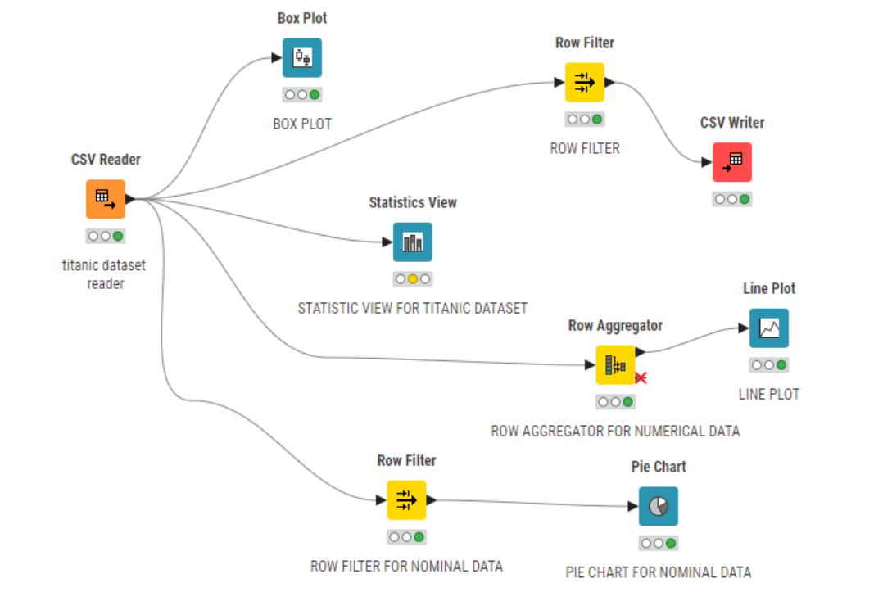
Example 03 : descriptive workflow:

Slide 35
Task:
Task 1: As part of a data analysis project, the team is investigating the Titanic dataset to uncover insights into passenger survival rates. One of the analysis tasks involves Implement the box plot and histogram for Titanic Data Set

Slide 36
Task 2:
In a workflow group create an empty workflow “ Titanic Analysis”
A) read CSV file
B) remove irrelevant columns
C) enter the name and description for all nodes
D) performed basic statistics
E) performed the column and row filter and finally write the data to output file
F) save and execute workflow.

Slide 37
Task 3:
Task : Using KNIME, the team will analyze the Titanic dataset to identify the total number of male passengers who survived the disaster. This analysis will provide valuable insights into the survival patterns among male passengers aboard the Titanic, contributing to a better understanding of the factors influencing survival rates during the tragic event.

Slide 38
Task 4:
Task
Calculate the total number of medals and appearances by male athletes in swimming disciplines in the Olympic Games between 1920 and 2020 by athlete and overall.

